Slide 1

Today's Agenda
01
List Basic Concepts
01
05
List comprehension
Access List Items
02
06
Sort, Copy & Join Lists
Change, Add & Remove list Items
03
07
Lists Methods
Loop Lists
04
08
Practice Problems – 6.30

Slide 2
02
List Basic Concepts

Slide 3
Python Data Types
03
Python Data Types
Text Type | str
Numeric Types | int, float, complex
Sequence Types | list, tuple, range
Mapping Type | dict
Set Types | set, frozenset
Boolean Type | bool
Binary Types | bytes, bytearray, memoryview
None Type | nonetype

Slide 4

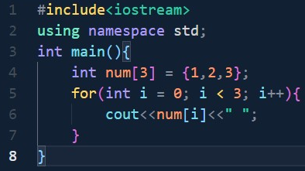


List Syntax - 01
04
List items are ordered, changeable, and allow duplicate values.

Slide 5



List Syntax - Types of output
05

Slide 6


List type()
06

Slide 7
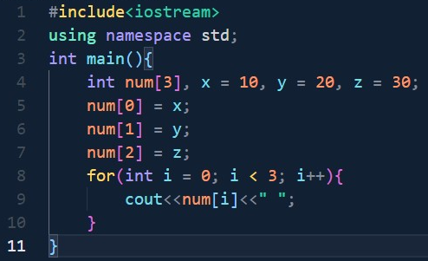
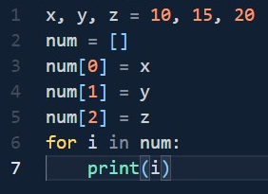


List Constructor - 01
07

Slide 8



List Constructor - 02
08

Slide 9
19
Access List Items

Slide 10



Access Items - 01
10

Slide 11


Access Items - 02
11

Slide 12
12
Change, Add & Remove List Items

Slide 13


Change List Items
13

Slide 14
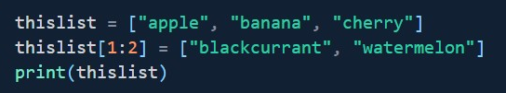


Change a range of item values
14

Slide 15

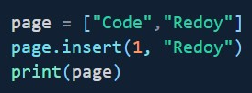
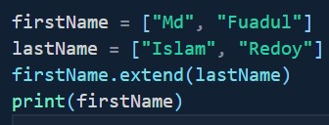

Add List Items – append(), insert(), extend()
15

Slide 16

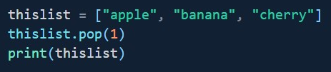





Remove List Items – remove(), pop(), clear(), del
16

Slide 17
17
List Comprehension

Slide 18
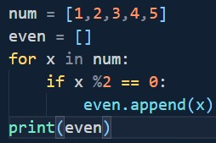


List Comprehension - Example - 01
18

Slide 19
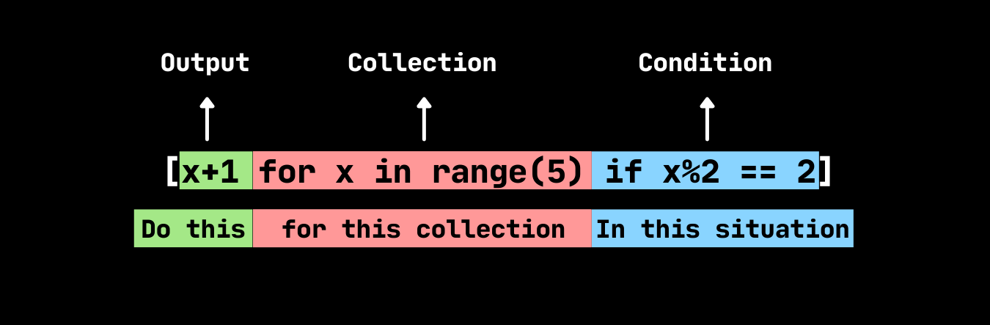
List Comprehension - Syntax
19
newlist = [expression for item in iterable if condition == True]

Slide 20
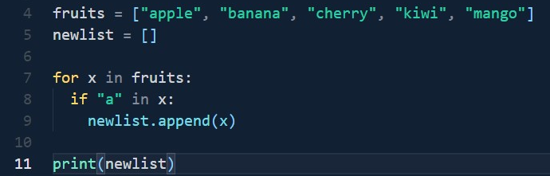
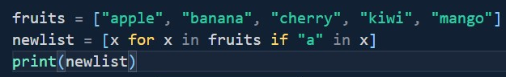

List Comprehension – Example - 02
20

Slide 21


List Comprehension with range() – Example - 03
21

Slide 22
List Comprehension – Example – 04
22

Slide 23
23
Sort, Copy & Join List

Slide 24
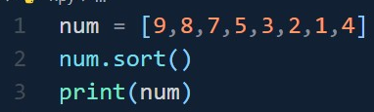
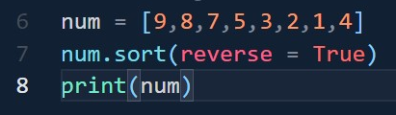

Ascending Sort
Descending Sort
24

Slide 25
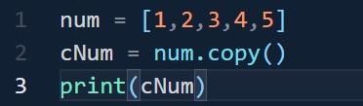

Copy using copy()
Copy using list()
25

Slide 26
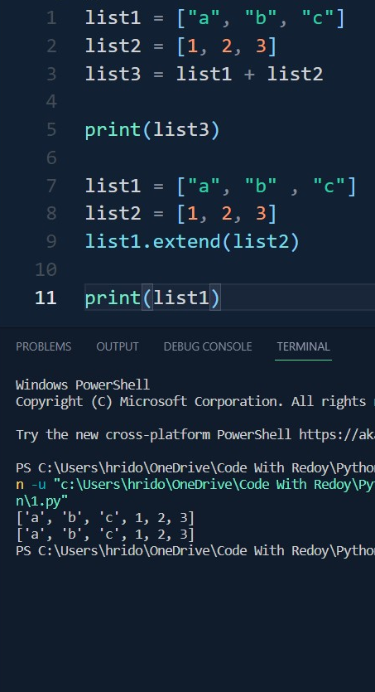
Join using +
Join using extend()
26

Slide 27
27
Practice Problem – 6.30
1
Take 10 space-separated integer and make a list. Then find the sum and average of these all numbers.
10
20
Python program to print all positive numbers in a range
Python reversing a List in Python
2
Python Program to find largest and smallest number using list.
11
Python program to find second largest number in a list
21
How to count unique values inside a list
3
Python Program to copy a list and store it another list.
12
Python program to print even numbers in a list
22
Python program to check if the list contains three consecutive common numbers in Python
4
Python Program to arrange a set of number in an ascending order.
13
Python program to print all even numbers in a range
23
Python Program to print all Possible Combinations from the three Digits
Python Program to arrange a set of number in an ascending order and find the largest and lowest value.
14
Python program to count Even and Odd numbers in a List
24
Remove all the occurrences of an element from a list in Python
5
15
Python program to print positive numbers in a list
25
Python | Ways to find length of list
6
Python Program to make Fibonacci series using list.
16
Python program to print negative numbers in a list
26
27
Problem Link
Problem Link
7
Python program to check whether a character is alphabet or not.
17
Python program to count positive and negative numbers in a list
28
29
Problem Link
Problem Link
8
Python program to swap two elements in a list.
18
Python program to Check if element exists in list or not.
30
Problem Link
9
Python program to interchange first and last elements in a list
19
Python Program to multiply all numbers in the list

Slide 28
Today's Agenda
01
Set Basic Concepts
01
05
Loop sets
Access set items
02
06
Join sets
Add set items
03
07
Set Methods
Remove set items
04
08
Practice Problems – 7.20

Slide 29
02
Set Basic Concepts

Slide 30
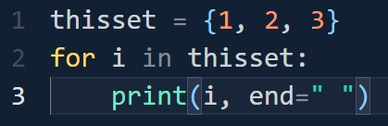
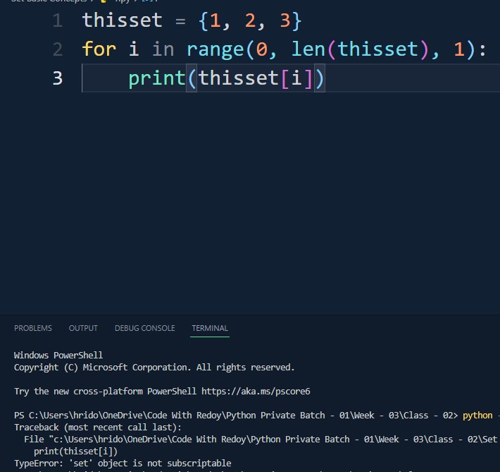
Set Syntax - 01
03
*Sets are unordered, so you cannot be sure in which order the items will appear.
*Unordered means that the items in a set do not have a defined order.
*Set items can appear in a different order every time you use them, and cannot be referred to by index or key.
*Set items are unchangeable, meaning that we cannot change the items after the set has been created.
*Once a set is created, you cannot change its items, but you can remove items and add new items.

Slide 31
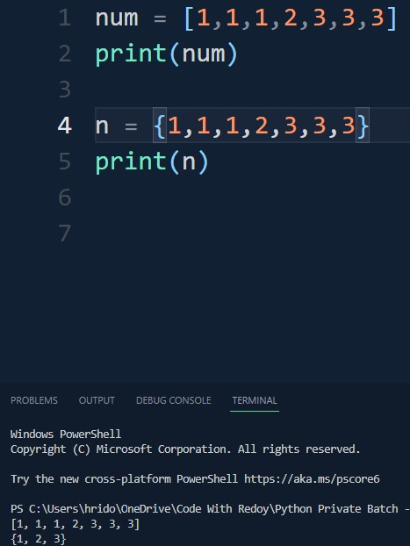

Duplicate Values
04

Slide 32
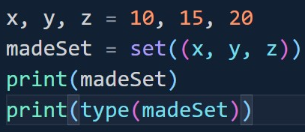

Set Constructor
05

Slide 33
07
Access Set Items

Slide 34
Access Set Items
08
Same as list

Slide 35
09
Add Set items

Slide 36
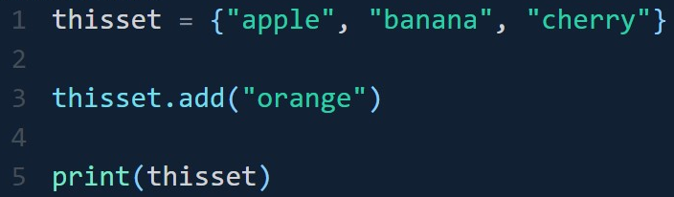


Add Set items – 1
10

Slide 37
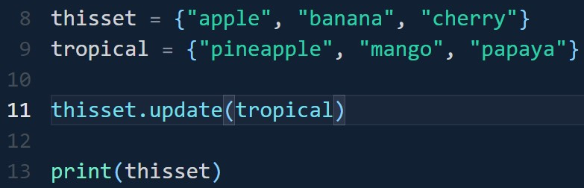

Add two set items - 02
11

Slide 38
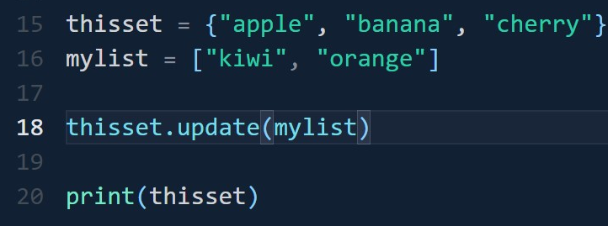
Add Set items with list items - 03
12
Tell me the output

Slide 39
13
Remove Set items

Slide 40
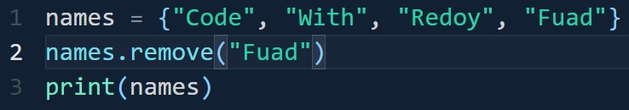
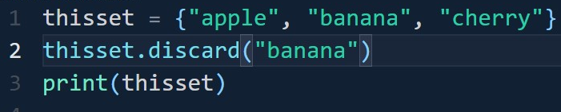
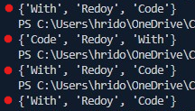
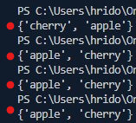
Remove Set items – remove(), discard()
14
If the item to remove does not exist, remove() will raise an error.
If the item to remove does not exist, discard() will NOT raise an error.

Slide 41
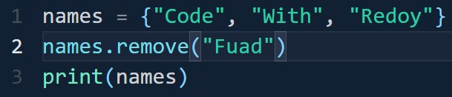
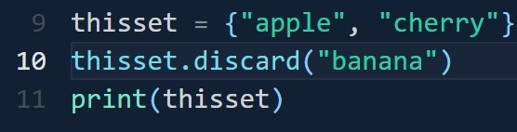


Remove Set items – remove(), discard()
15

Slide 42
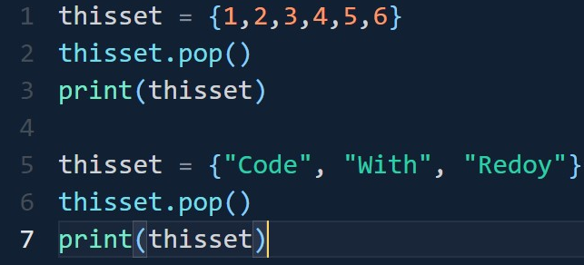
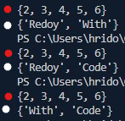
Remove Set items – pop()
16

Slide 43
17
Loop Sets

Slide 44
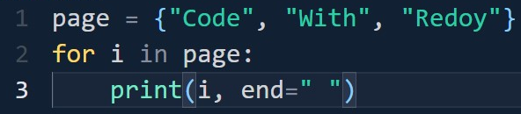
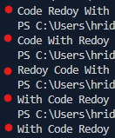
Loop Sets
18

Slide 45
19
Join Sets

Slide 46
20
Article

Slide 47
21
Practice Problem – 7.20
1
10
Python program to convert Set to String
20
Find the size of a Set in Python
Problem Link
2
11
Python program to convert String to Set
Iterate over a set in Python
3
Python – Maximum and Minimum in a Set
12
Python program to get all subsets of given size of a set.
4
13
Problem Link
Python – Remove items from Set
14
Problem Link
5
Python program to find common elements in three lists using sets
15
Problem Link
6
Python program to count number of vowels using sets in given string
16
Problem Link
7
Concatenated string with uncommon characters in Python
17
Problem Link
8
Python Set – Pairs of complete strings in two sets
18
Problem Link
19
9
Python program to convert set into a list
Problem Link

Slide 48
22
Assignment of Week – 3
1
Python – Check if two lists have at-least one element common
11
Problem Link
21
Problem Link
2
Python – Find missing and additional values in two lists
12
Problem Link
22
ProblemLink
3
Python program to find the difference between two lists
13
ProblemLink
23
ProblemLink
4
Python – Program to accept the strings which contains all vowels
14
Problem Link
24
Problem Link
Python – Check if a given string is binary string or not
15
ProblemLink
25
5
Problem Link
16
Problem Link
26
6
Python program to check whether a given string is Heterogram or not
Problem Link
17
ProblemLink
27
7
Python – Intersection of two lists
Problem Link
8
18
ProblemLink
Problem Link
28
Problem Link
9
19
Problem Link
Problem Link
29
Problem Link
10
20
ProblemLink
Problem Link
30
Problem Link

